Slide 1
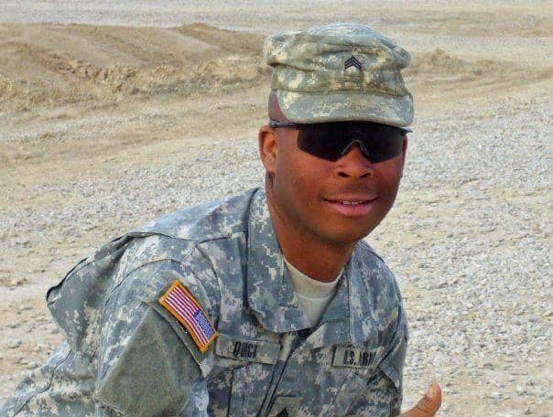
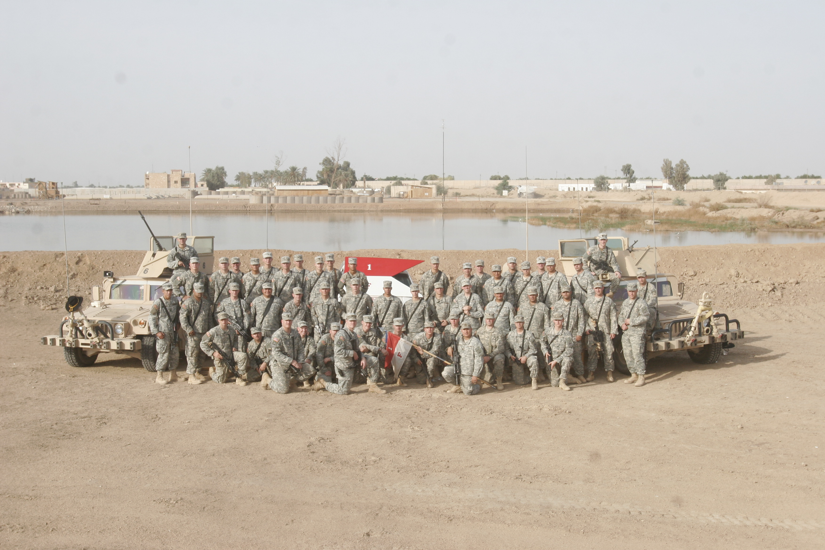
Recommendation for Upgrade
SGT Marquees A. Quick’s Award to
Medal of Honor (Posthumous)
SGT Marquees A. Quick's extraordinary heroism on 19 August 2006 warrants upgrade to the Medal of Honor

Slide 2
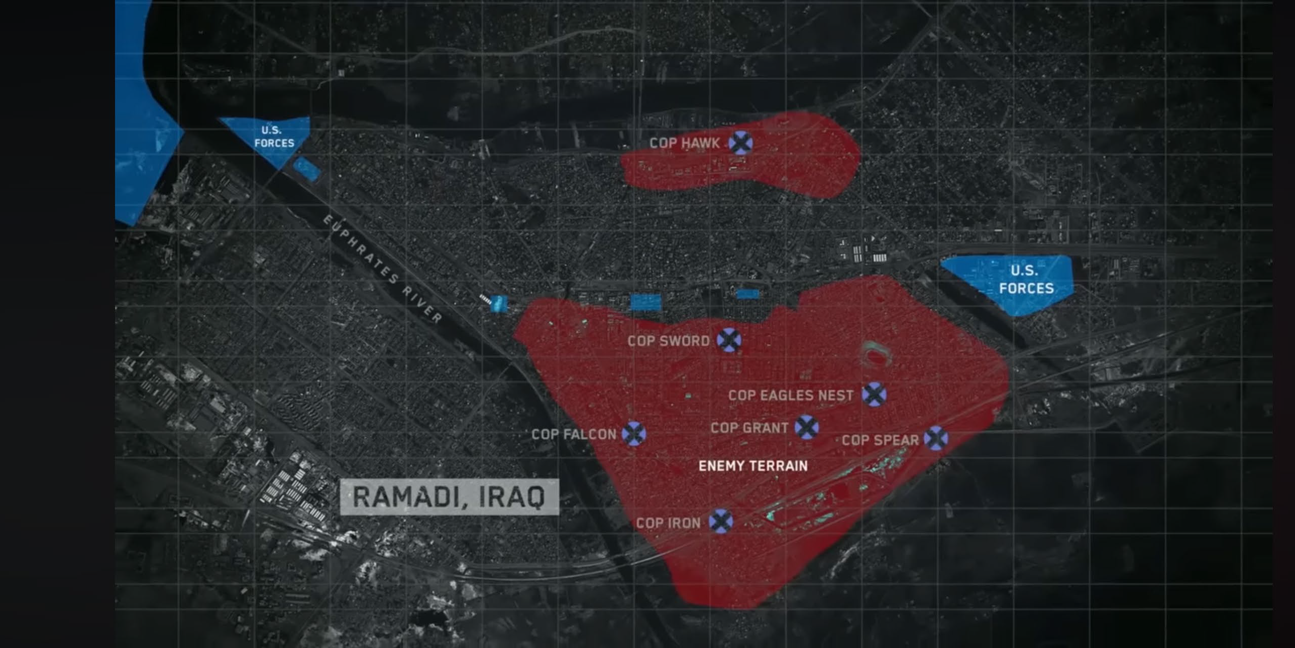
AO and Mission Overview
AO Description
Ar-Ramadi was the central hub of the Sunni insurgency in Iraq. Al-Qaeda in Iraq (AQI) controlled more than 70% of the city when 1/1 AD arrived in Spring of 2006.
From June to August 2006, the Brigade averaged 46 enemy actions per day.
The Area was comprised of dense urban environment with multi-story buildings in close proximity.
Enemy Forces in the area were capable of complex operations including artillery fire, well coordinated ground attacks, ambushes, and emplacing highly effective Improvised Explosive Devices (IEDs).
In June of 2006 1/1 AD began offensive operations to establish multiple Combat Outpost (COP) deep in enemy territory. COP Iron, Sword, Falcon, and Grant were occupied by small US forces to force AQI from the city.
The Brigade Reconnaissance Troop conducted operations in every area of the Brigade’s sector and suffered nearly 50% casualties wounded or killed in action.
Mission
On 19 August 2006, 2nd Platoon conducted a specialized reconnaissance mission in support offensive operations in Southern Ramadi. The unit was tasked with identifying and eliminating insurgents emplacing IEDs on roads surrounding COP Grant.
CDR’s Intent
Engage and Destroy all insurgent teams attempting to place IEDs along the Main Supply Route to COP Grant. Neutralize enemy threats, provide overwatch, and maintain security amid high insurgent activity in a contested battlespace.
AQI = Al-Qaeda in Iraq
COP = Combat Outpost
IED = Improvised Explosive Device

Slide 3
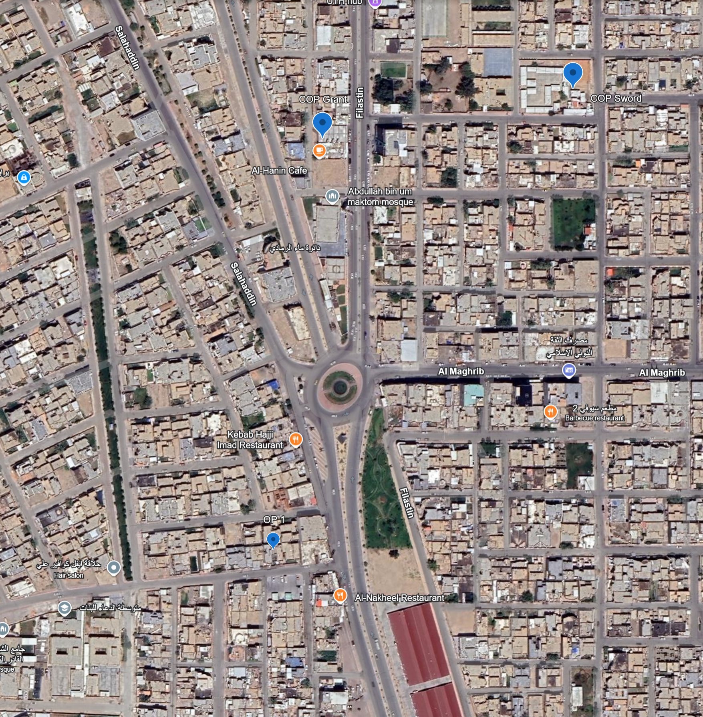
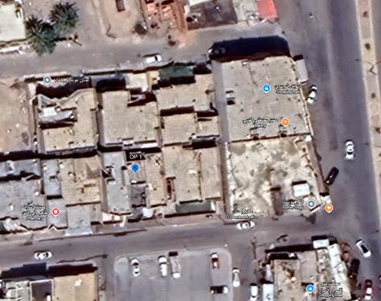
Infiltration and Initial Actions
Key Locations
  COP Grant: Start point for 2nd platoon’s mission.
  Observation Post 1 (OP 1):
    Two-story structure 2nd platoon occupied as an OP to observe a tier 1 IED site. Adjacent buildings cleared but inaccessible
Timeline of Events:
0230 – 0400 hours:
  Depart COP Grant under cover of darkness; move to target sector
  Arrive at target block; attempt entry on initial houses (doors locked; deliberate breach avoided to maintain stealth)
  Enter alternate two-story house; secure courtyard, clear rooms, consolidate family in living room.
0400 hours:
  Establish rooftop positions:
    SGT Quick at northeast corner (M240B covering east avenue and objective)
    SGT Barr at southwest corner (M249 covering north roof threat); SGT Rodriguez-DeJesus rotating.
    SGT Wall south of Quick (sniper overwatch)
  Ground Floor Security: SFC Olienyk, SPC Ruiz-Soto, PFC Herrud, Interpreter with family.
0630 – 1000 hours:
  Observed only light traffic and children
  Initiate a rotational rest plan
COP Grant
COP Sword
N
1
2
OP 1
OP 1
3
1
2
3
COP = Combat Outpost
IED = Improvised Explosive Device
OP = Observation Post

Slide 4

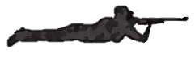


Enemy Contact and SGT Quick’s Heroic Actions
1015 hours
  Enemy launches coordinated attack with 4 grenades thrown onto rooftop.
  SGT Barr yells “GRENADE” three times; warns team and attempts to seek cover
  Other Team Members react and seek cover
Actions of SGT Quick
  SGT Quick immediately moves from his position to save his teammates. The Stairwell was right there for SGT Quick to access
  SGT Quick deliberately throws himself onto the grenades, attempting to shield his teammates from the full blast by sacrificing his life for theirs
Result:
  SGT Quick mortally wounded
  SGT Barr (shrapnel in foot/buttocks)
  SGT Rodriguez-DeJesus (shrapnel wounds in back)
  SGT Wall (shrapnel in leg)
SGT Barr treats remaining causalities, reestablishes security w/ SGT Wall and prepares for extraction with team
  Casualties are evacuated to inner room for continued treatment and prepped for extraction
Grenade
Direction of Flight
N
SGT Rodriguez found after the attack
1
1
Position of SGTs Rodriguez & Barr before the attack
Stairs
2
2
Roof (with wall)
Position of SGT Wall (prior and when found)
Route of SPC Ruiz and Herrud.
Courtyard gate to waiting BFVs and CASEVAC

Slide 5
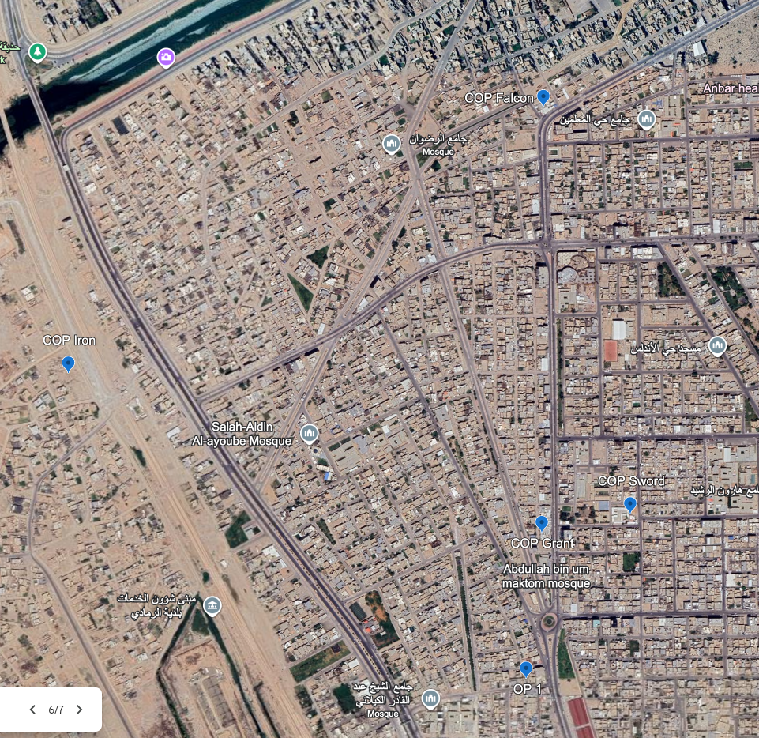
Evacuation, Exfiltration, and Movement to Camp Ramadi
B Co 1-36 IN, Attached to 1-37 AR
  Arrives and load SGT Quick into Bradley Fighting Vehicle. They move to COP Falcon where Battalion Field Aid Station is located.
  LTC Tedesco (1-37 AR TF CDR) is on scene at COP Falcon.
  SGT Quick then transported to Camp Ramadi where he is pronounced deceased and moved to the Morgue.
SGT Quick’s heroic actions are consistent with the fatal injuries that 1SG Pinion observed during the morgue identification
2nd Platoon actions
  1115 hours: Casualties were evacuated back to COP Grant. Remaining team members mounted vehicles and prepared to execute movement back to Camp Ramadi
  1400 hours: OP 2 extracted to COP Iron. Moved from COP Iron to COP Grant
  1430: While in route back to Camp Ramadi, 2nd Platoon moves from COP Grant to COP Falcon. RPG attack
  1445 hours: IED Attack. 2ea IEDs. No casualties
  1451 hours: Arrive Camp Ramadi
4
IED Attacks
COP Falcon
RPG Attack
COP Iron
3
2
1
1
2
COP Sword
COP Grant
3
4
N
OP 1
COP = Combat Outpost
IED = Improvised Explosive Device
OP = Observation Post
RPG = Rocket Propelled Grenade

Slide 6
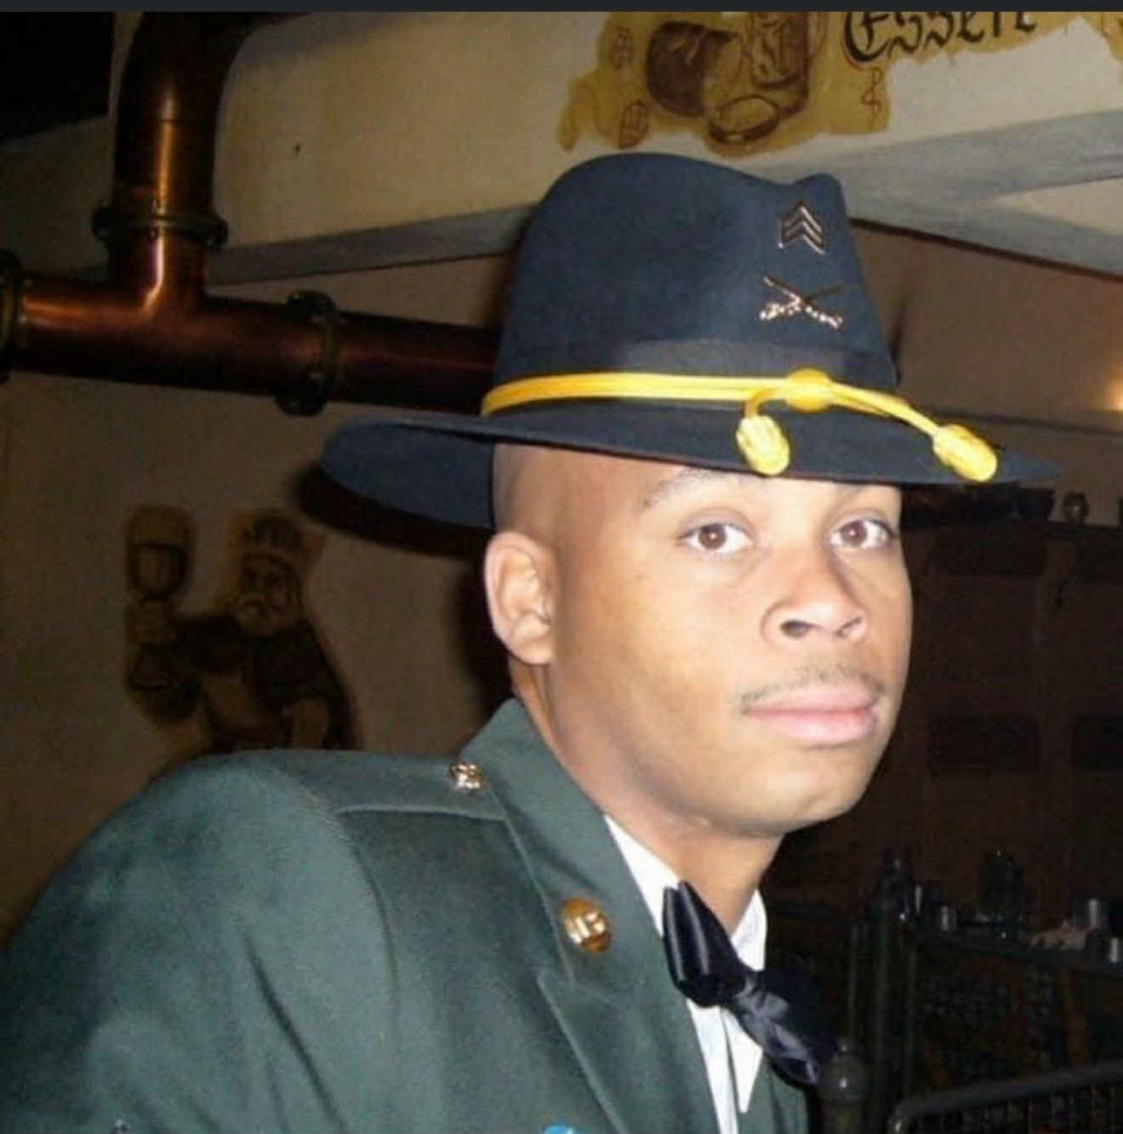
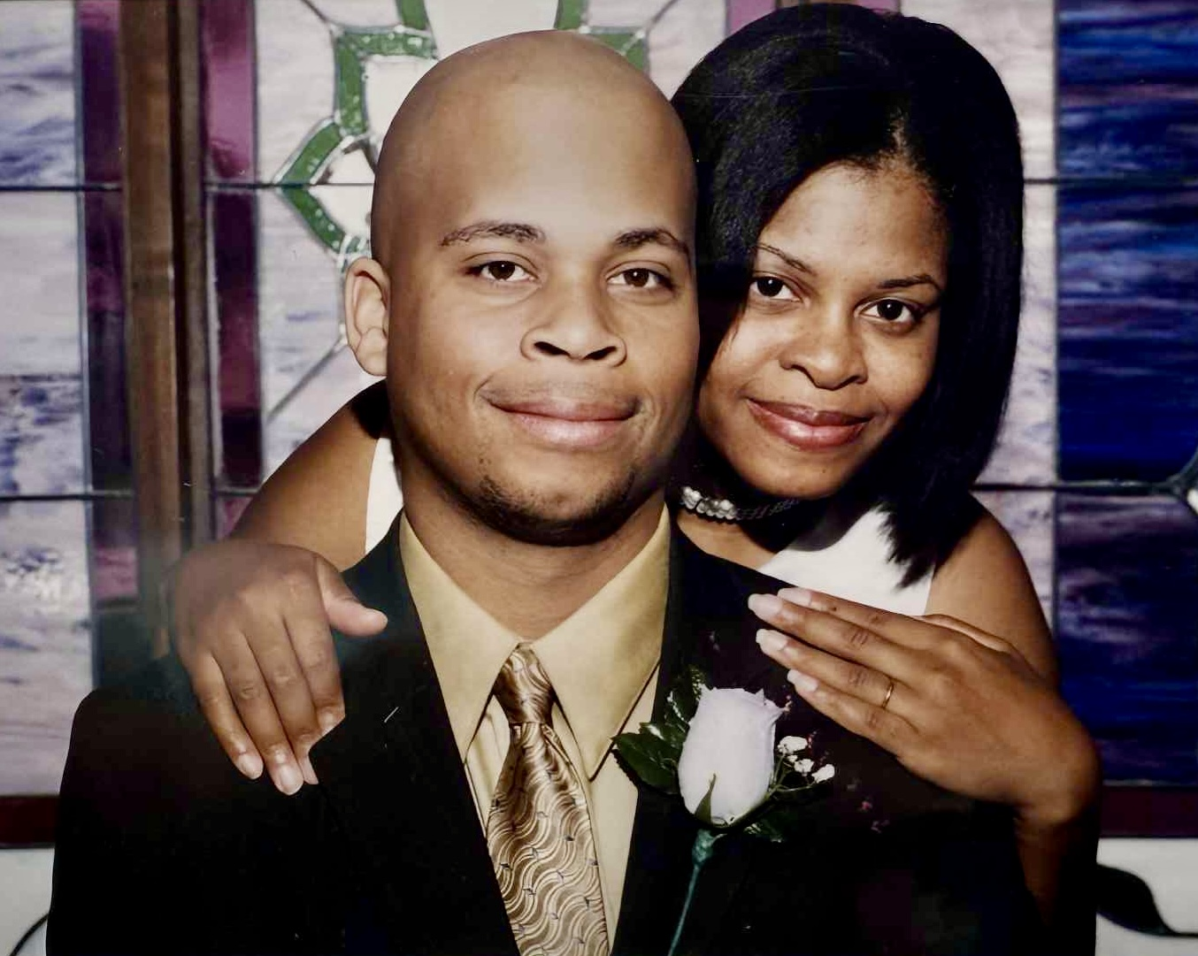
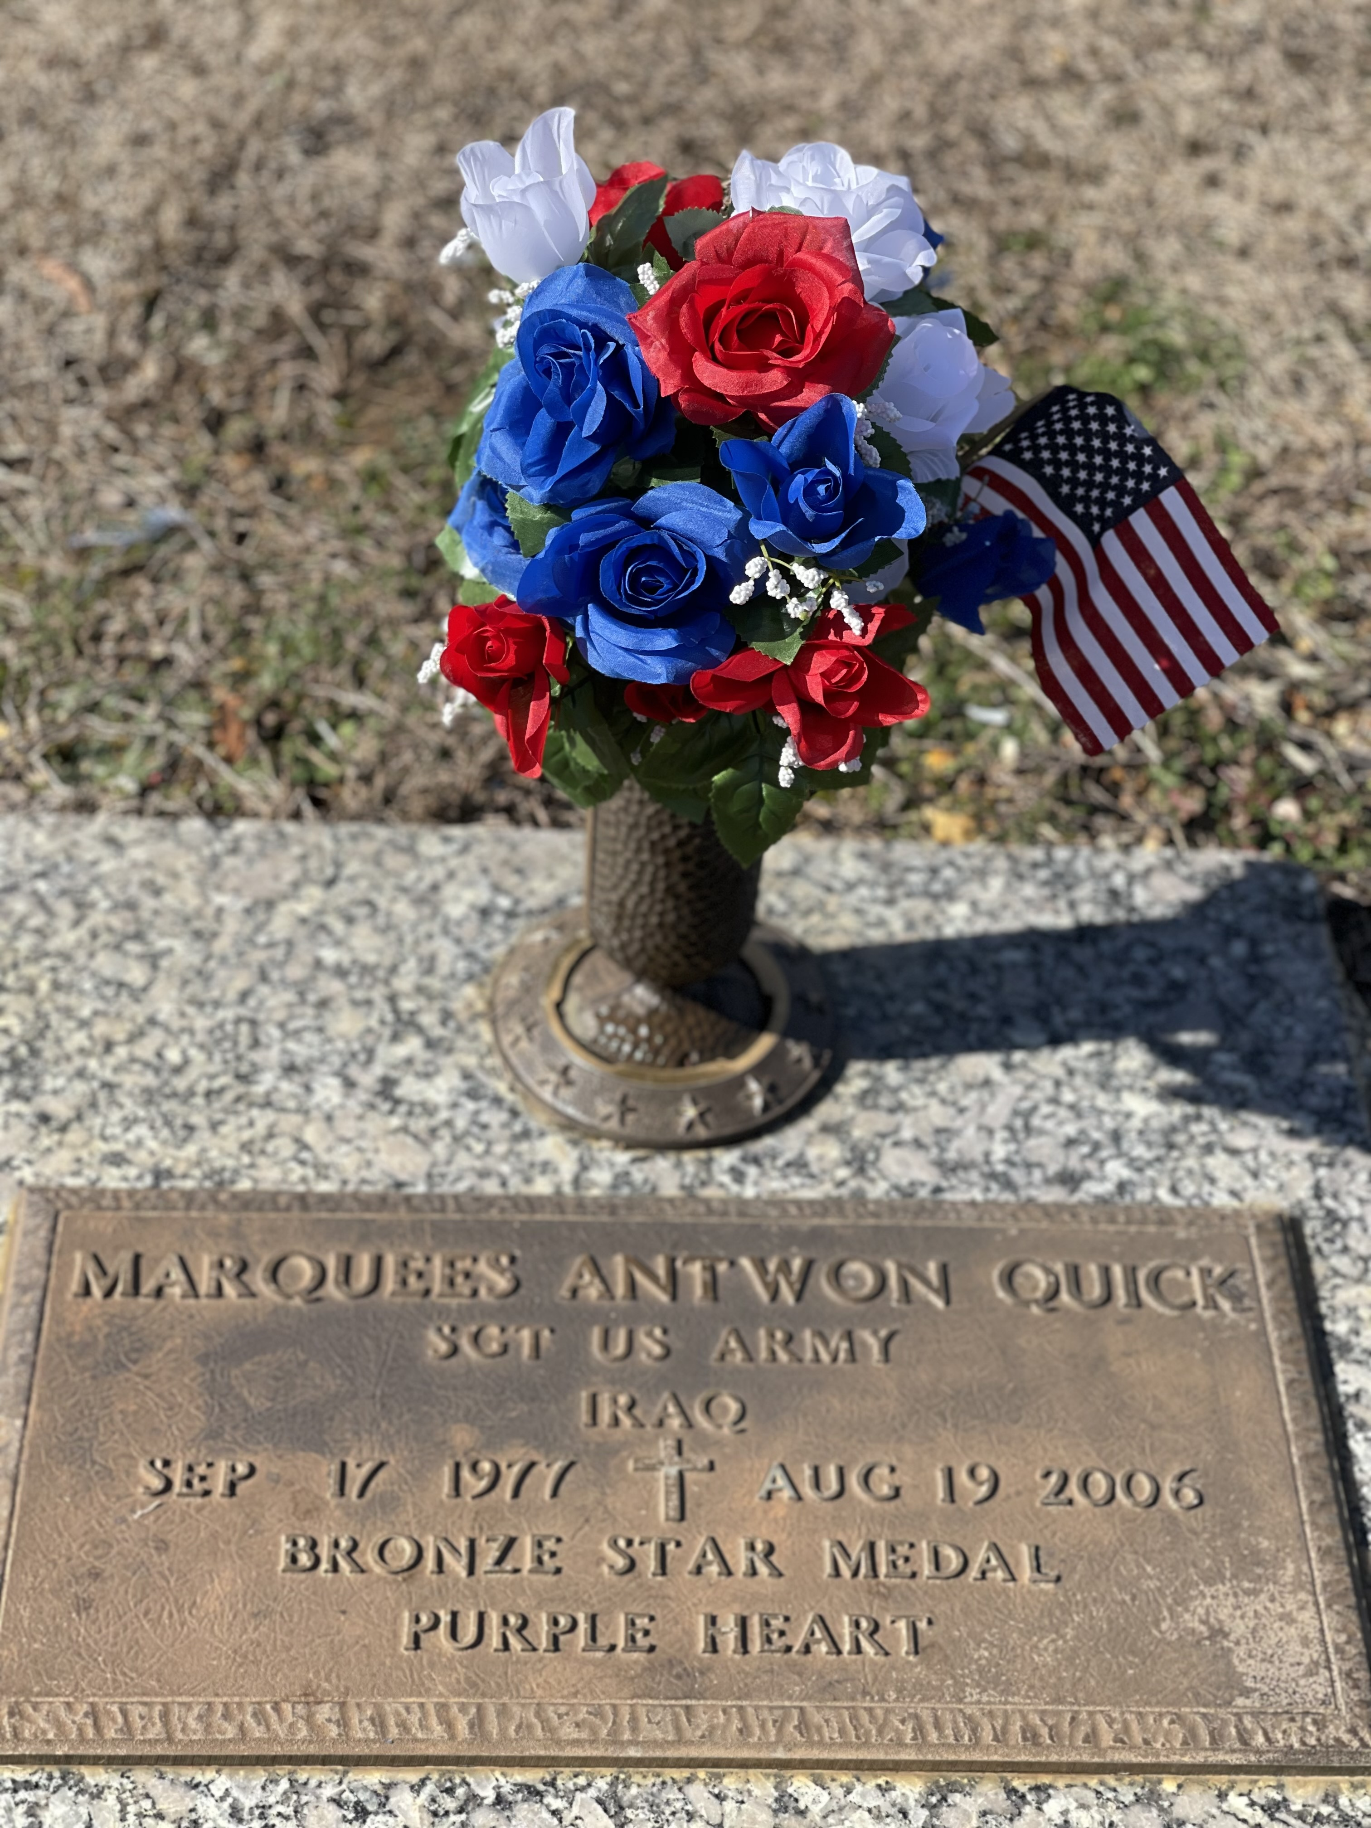
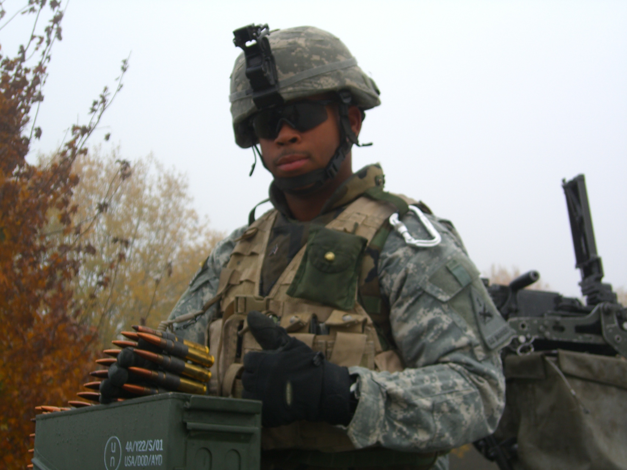
Summary and Recommendation
SGT Quick's actions meet the criteria for the Medal of Honor due to his conspicuous gallantry and intrepidity at the risk of his life above and beyond the call of duty.
Without hesitation, SGT Quick, with a clear path to relative safety down the stairwell only meters away, deliberately and without regard for his own life, threw himself between the grenades and his fellow Soldiers, shielding them from the blasts. This selfless action absorbed the full force of the explosions, saving the lives of SGT Barr, SGT Rodriguez-DeJesus, and SGT Wall, and preventing further casualties to the team.
His extraordinary bravery and uncommon valor resulted in SGT Quick gallantly sacrificing himself to defend his brothers-in-arms and his nation.
SGT Quick’s deliberate and immediate sacrifice mirrors that of CPL Jason Dunham, who received the Medal of Honor in 2004 for similar actions. Like PFC Ross McGinnis, MAA Michael Monsoor, and LCpl Kyle Carpenter, SGT Quick, without hesitation, chose to protect his comrades from the deadly effects of a grenade, fully aware of the consequences.
Sergeant Marquees A. Quick exemplified the United States Army Creed of the Noncommissioned Officer, placing his Soldiers' welfare above his own without regard for his personal safety.

Slide 7
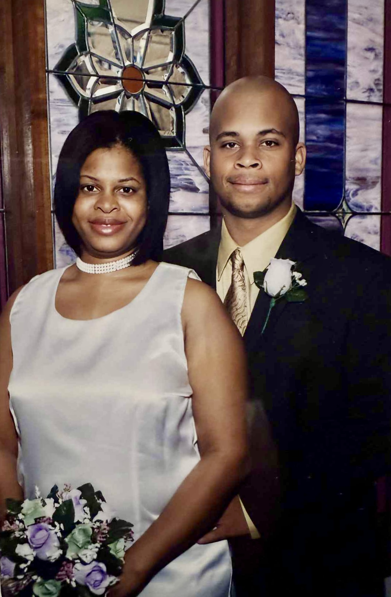
Marquees Antwon Quick
Marquees was born 17 September 1977 in New York but relocated to Center Point, Alabama when he was young. He attended Huffman High School, class of 1996. He was a family man who saw or called his mom and grandmom every day. Marquees was the oldest of three brothers: Matthew, Brandon, and Keith Quick.
Marquees served an initial tour on Active Duty, left and joined the Alabama National Guard, met his wife at Church, and after 9/11 transitioned back to active duty because he knew he didn’t want to be left on the sidelines potentially.
From Marquees wife “Marquees was a loving husband, a great leader, and motivator with a big heart – and a big head…as he would joke. He often joked that I was a cougar because I was 2 ½ weeks older than him. Marquees took his role as a Leader to heart and NEVER wanted to let his men down. Marquees was my best friend, husband, and cheerleader. The family misses you dearly, SGT Marquees A. Quick. Gone but never forgotten. Love always, your wifey.”
SGT Marquees A. Quick is buried at Zion Memorial Gardens in Birmingham Alabama.

Slide 8
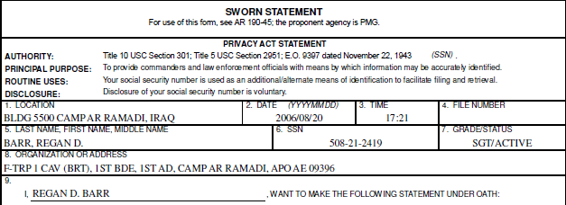

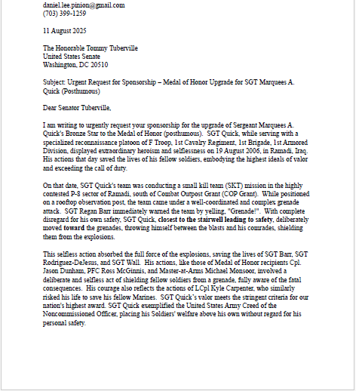
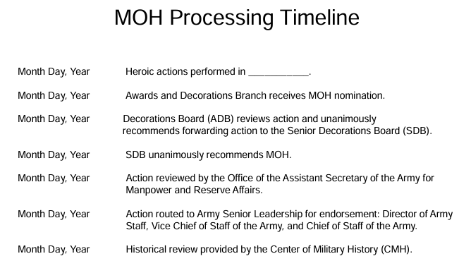
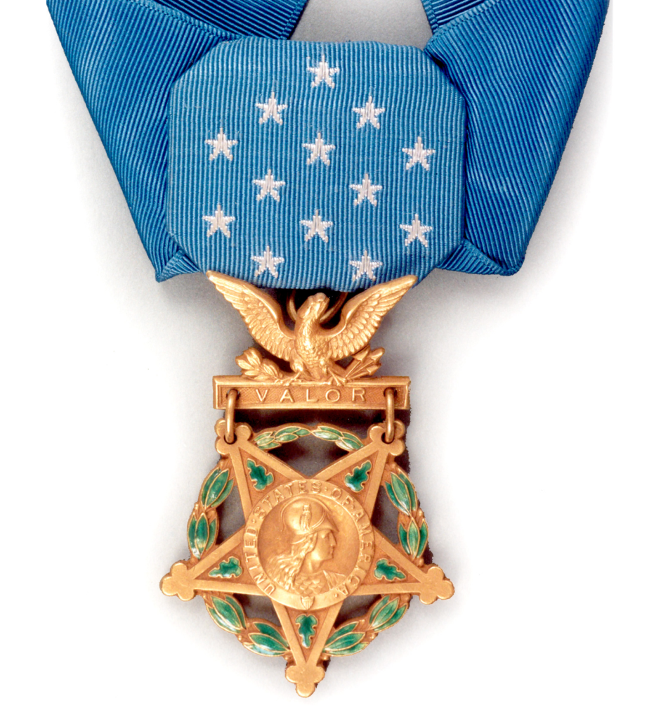
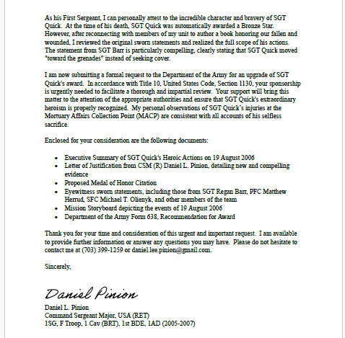


Medal of Honor Upgrade Process: Honoring SGT Quick's Valor
Step 1: Documentation & Justification
Gather new and compelling evidence that demonstrates the act of valor warrants the Medal of Honor.
Step 2:
Formal Request & Review
Formal Recommendations needs to be reviewed and submitted in packet form
Step 3: Congressional Sponsorship
Congressional sponsorship is required for review from a Member of the U.S. Senate or House of Representatives per Title 10 U.S. Code Section 1130 when greater than 1 year has passed.
Step 4:
Army Awards Board Review
Once sponsorship happens, that is presented to the Army Awards Board. The Army Awards Board will evaluate and determine worth.
Step 5: Presidential Approval
If approved by the Army Awards Board, the recommendation is forwarded to the President of the United States for final approval.
This includes sworn statements, official records, and a detailed letter of justification.
Initially Submitted to 1AD Commanding General on 11 August 2025. Updating Storyboard.

Slide 9
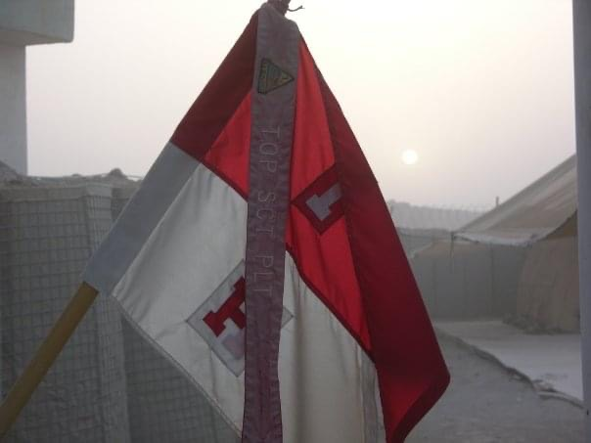
Recommendation for Upgrade SGT Marquees A. Quick’s Award to Medal of Honor (Posthumous)
Share this video and SGT Marquees Quick’s story widely
Contact your own congressional representatives—call, email, or write—and urge them to sponsor or support this upgrade
Visit www.dpinion.com where we will post a sample template to write your congressional representatives and provide updates on the process

